Slide 1
Trigonometry Ratios – Finding an Angle
Year 10 Mathematics

Slide 2
Contents
Formula Page
Page
Date
Description
2
3

Slide 3

Tasks
24
7
30
Essential Question
You should be ticking these off!
Complete the tasks on this side (left) of your page
Questions
Notes
Steps
Write your notes on this side (right) of your page
Your book, your responsibility!
Summary
Have YOU been doing your summaries?

Slide 4
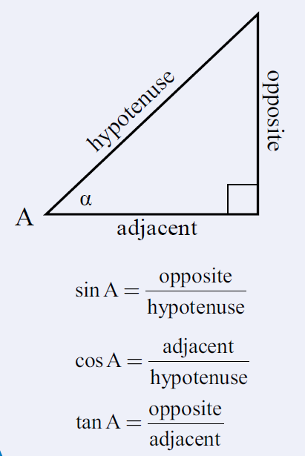
24
7
30
Date: /9/2018
Trigonometry
EQ – How do we find an angle of a right angled triangle using trigonometry ratios?
From our last lesson
What are the trigonometry ratios?
25

Slide 5
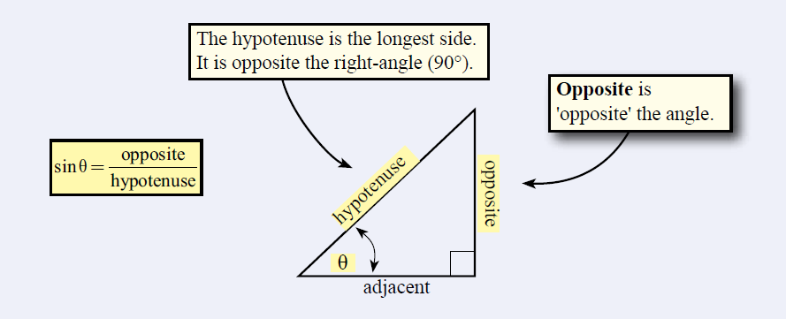
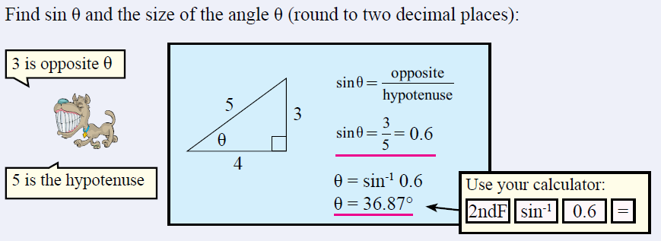
24
7
30
Date: /9/2018
Trigonometry
EQ – How do we find an angle of a right angled triangle using trigonometry ratios?
The sine ratio
25

Slide 6
Ex. 3: Find θ. Round to three decimal places.
200
400
2nd
sin
200
400
)

Slide 7
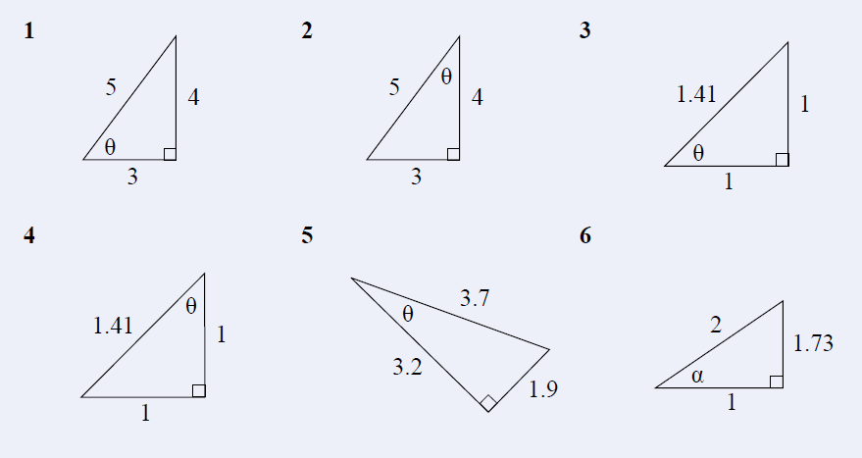
Task

Slide 8
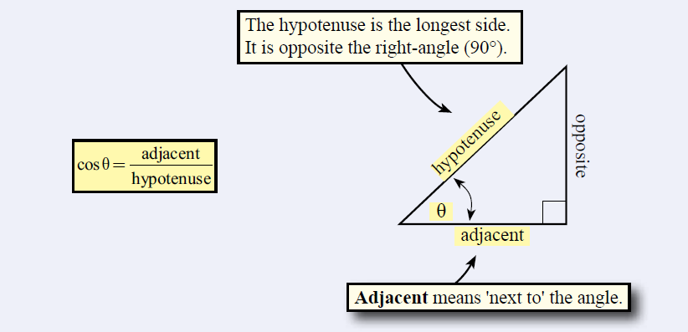
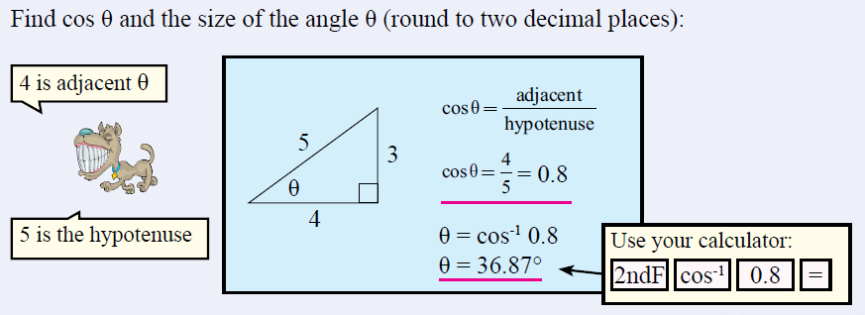
24
7
30
Date: /9/2018
Trigonometry
EQ – How do we find an angle of a right angled triangle using trigonometry ratios?
The cosine ratio
25

Slide 9
Ex. 2: Find θ. Round to three decimal places.
7
2nd
cos
7
23
)
23
Make sure you are in degree mode (not radians).

Slide 10
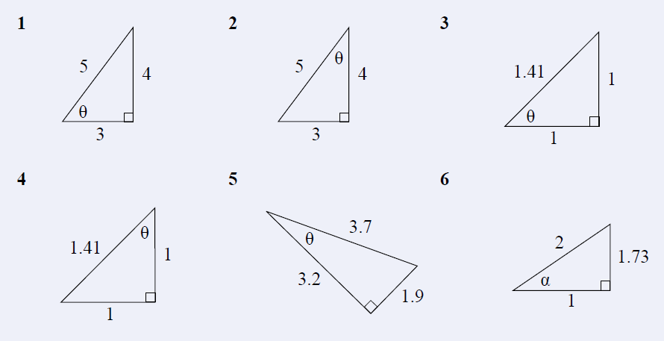
Task

Slide 11
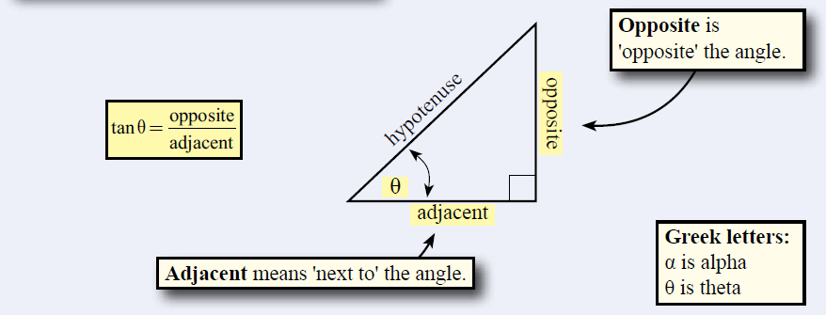
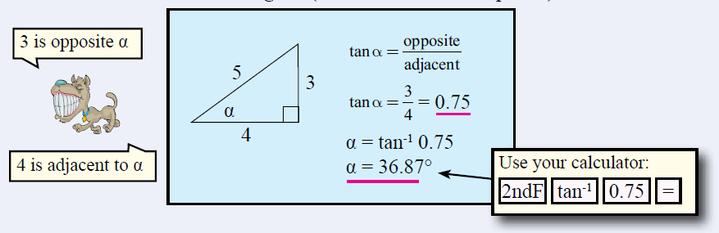
24
7
30
Date: /9/2018
Trigonometry
EQ – How do we find an angle of a right angled triangle using trigonometry ratios?
The tangent ratio
25

Slide 12
Ex. 1: Find θ. Round to four decimal places.
2nd
tan
17.2
9
)
17.2
9
Shrink yourself down and stand where the angle is.
Now, figure out which trig ratio you have and set up the problem.

Slide 13
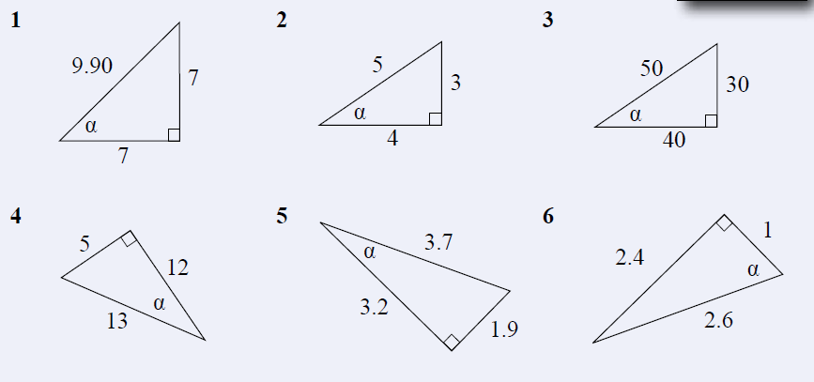
Task

